Slide 1
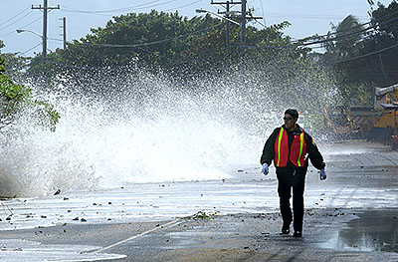
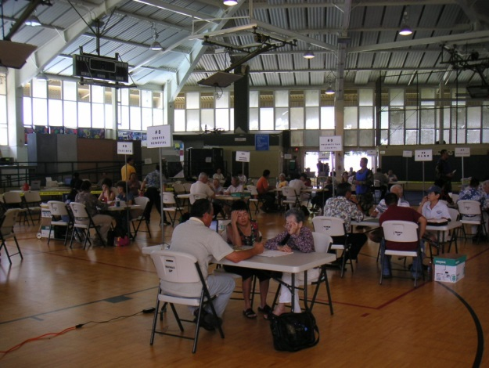
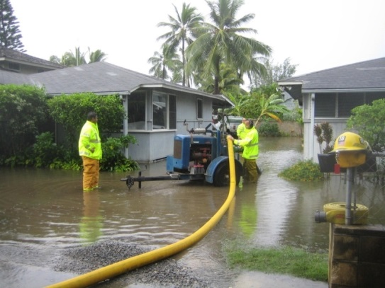
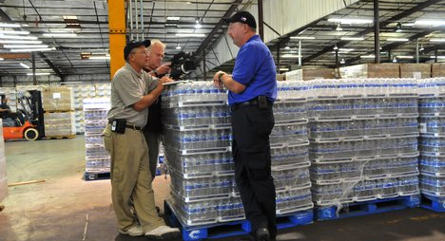
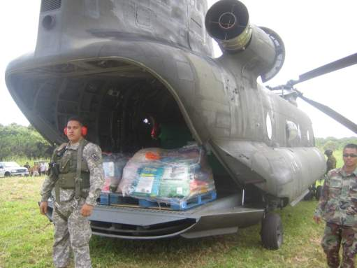
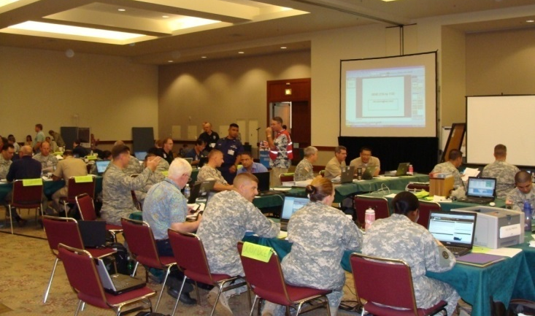
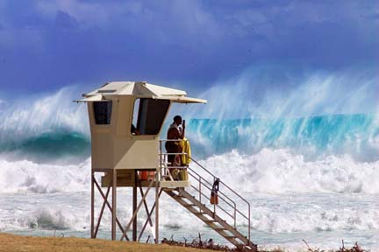
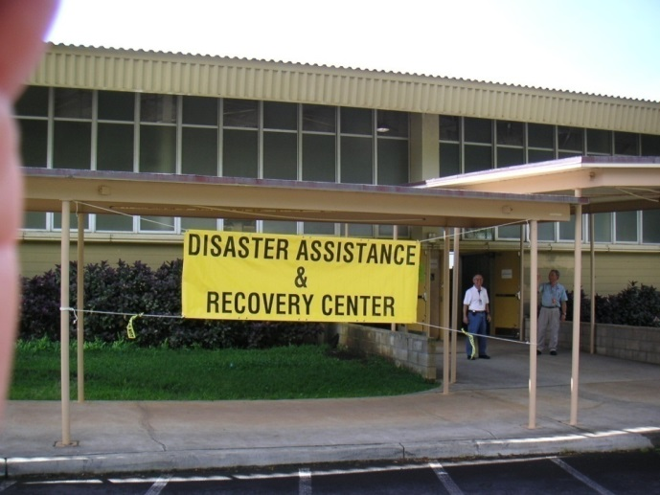
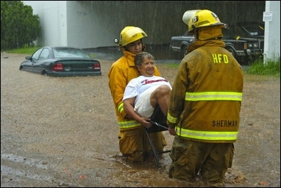
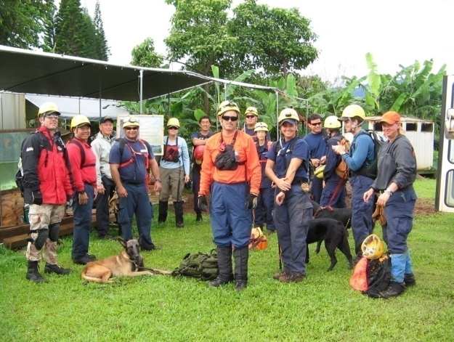
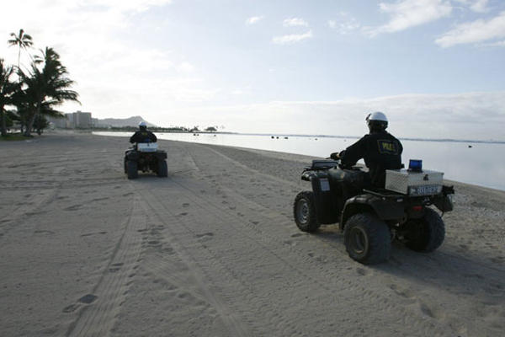
PREPAREDNESS BASICS
HAWAII EMERGENCY
MANAGEMENT AGENCY
10/10/2018

Slide 2
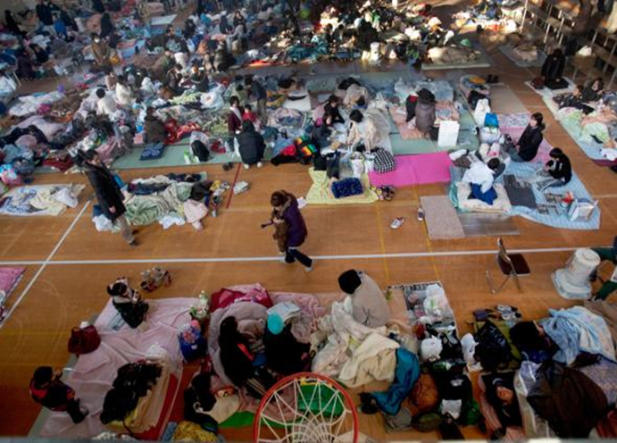
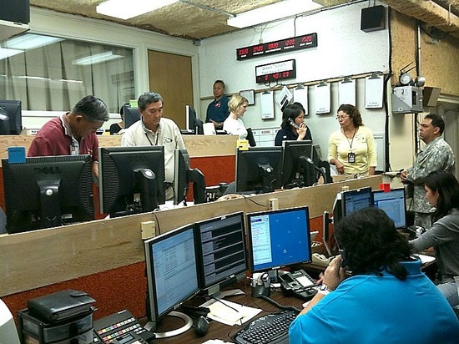
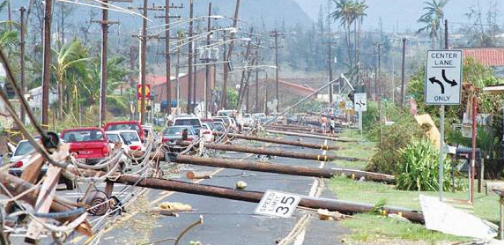
Mission
To help Hawaii’s residents and visitors prepare for and respond to disasters and emergencies.

Slide 3
Preparedness
An informed public that knows what to expect and what to do for all disasters…before they happen.
Notes:
Preparation means knowing what to do and when to do it.

Slide 4
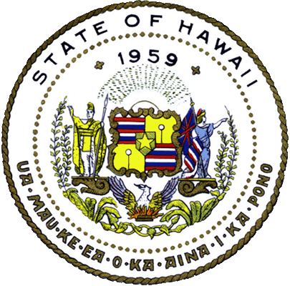
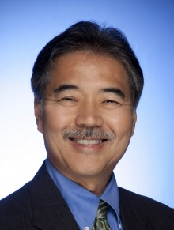
Office of the Governor
Hawaii State Department of Defense
David Y. Ige
Director of Emergency Management
Adjutant General / Homeland Security Advisor
Major General
Arthur J. (Joe) Logan
Deputy Adjutant General
HI-EMA
Hawaii
Army
National
Guard
Hawaii
Air
National
Guard
Homeland Security Office
Office of
Veterans
Services
HING
Youth
Challenge
Program

Slide 5
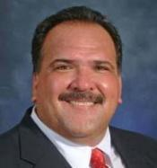
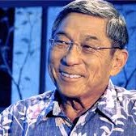
Hawaii Emergency Management Agency
MG Arthur J. Logan
Director of Emergency Management
Federal Emergency Management Agency (FEMA)
Thomas Travis
Administrator
Luke Meyers
Executive Officer
Preparedness Branch
Telecommunications
Branch
Finance/Admin
Branch
Operations
Branch
Logistics
Branch
Mayor Bernard Carvalho
Kauai County
Mayor Kirk Caldwell
City & County of Honolulu
Mayor Alan Arakawa
Maui County
Mayor Harry Kim
Hawaii County

Slide 6
Disaster Response and Assistance
Incident
First Responders
Notes:
All responses begin at the county level with first responders.

Slide 7
Disaster Response and Assistance
First Response
Warn & Evacuate
Assess situation
Declare a local state of emergency
Centralize coordination
Damage assessment
Request State assistance
County
Local Resources
Incident
First Responders
Notes:
County Government Responsibilities
Provide first response
Warn & evacuate residents and tourists
Assess situation to identify operational requirements
Declare a local state of emergency
Centralize coordination among local agencies
Conduct damage assessment
Request State assistance

Slide 8
Disaster Response and Assistance
Respond to requests for assistance
Activate the State EOC
Coordinate mutual aid/EMAC
Request Federal assistance
State
State + Other Resources
County
Local Resources
Incident
First Responders
Notes:
State Gov’t Responsibilities
Respond to requests for State assistance – the county must make a request.
Activate the State EOC
Apply the Governor’s unique authority to:
Declare a state of emergency
Mobilize the Hawaii National Guard
Redirect State resources to the emergency response
Coordinate mutual aid assistance/EMAC
Request Federal disaster assistance, federal disaster declaration – The state is the interface between the county and FEMA

Slide 9
Disaster Response and Assistance
Declare state of emergency
Mobilize Hawaii National Guard
Redirect State resources
Governor
State of Disaster
State
State + Other Resources
County
Local Resources
Incident
First Responders
Notes:
The state emergency declaration brings new resources to the table, particularly Hawaii National Guard and Air National Guard personnel and equipment.

Slide 10
Disaster Response and Assistance
Federal
Funding, Staffing, Defense
Governor
State of Disaster
State
State + Other Resources
Provide Federal assistance
Deploy Incident Management Assistance Teams (IMAT)
Coordinate with ESFs
Issue mission assignments
Track resources
County
Local Resources
Incident
First Responders
Notes:
Federal Responsibilities
Provide Federal assistance
Deploy Incident Management Assistance Teams (IMAT)
May establish a Joint Field Office (JFO)
Coordinate with 15 Federal Emergency Support Functions (ESFs)
Issue mission assignments
Track resources

Slide 11
Disaster Response and Assistance
Presidential Declaration
Additional Support
Federal
Funding, Staffing, Defense
Governor
State of Disaster
State
State + Other Resources
County
Local Resources
Incident
First Responders
Notes:
Again, this provides financial and other resources. The request itself is produced by the state, but FEMA provides excellent consultation on the application before they transmit it to the president for review.

Slide 12
Hawaii’s Hazard Profile
Notes:
Top 3 Hazards: Hurricane, tsunami, earthquake. HI-EMA performs an annual review of threats and assesses their likely impacts, but the top three are consistent. We know they’ll happen; we don’t know when.

Slide 13
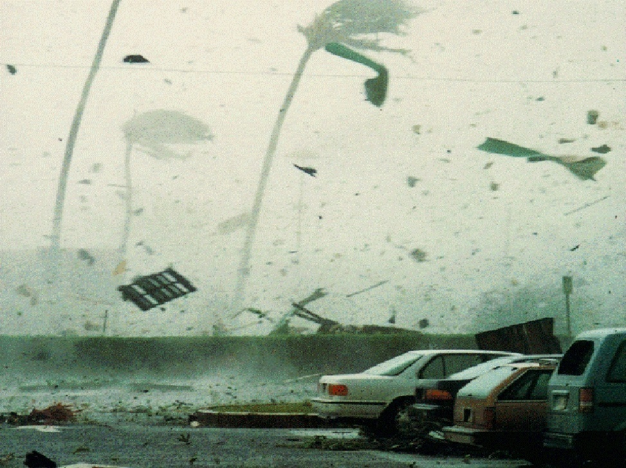
Hurricane Iniki – September 11, 1992
Category 4 – 145 mph
Six dead, more than 100 injured
Nearly 1,500 homes destroyed
5,000 sustained major damage
14,350 buildings were flattened or lost their roofs (Am Red Cross)
Estimated $1.8 billion in damage
View from the Kauai County Building
Notes:
A major hurricane is likely the most serious threat. A storm like Iniki hitting Honolulu could be devastating to the entire state.

Slide 14
Notes:
Our Critical Systems Planner, David Lopez, has compiled an excellent review of he potential impacts of a powerful hurricane on the state. I can’t present all of his findings, but here are the high spots. It is impossible to overstate how dependent we are on a constant flow of materials through the Port of Honolulu.

Slide 17
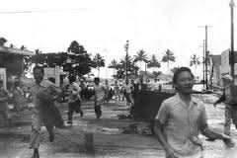
Hilo Tsunami - April 1, 1946

Slide 18
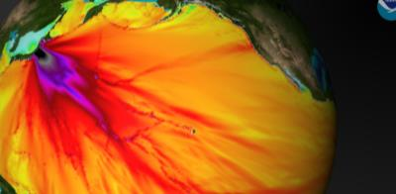
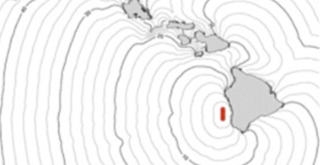
Tsunamis in Hawaii
Distantly Generated
Tsunami wave travel time will vary based on origin (a Tsunami from Japan would take about 8 hours to reach Hawaii)
Counties will sound sirens hourly and 30 min prior to wave arrival
Hurricane Evacuation Shelters will NOT open, Tsunami Refuge Areas may be announced
Locally Generated
If you are at the beach or a low lying area, and you feel an earthquake – evacuate to high ground immediately
A tsunami generated by an earthquake off the Island of Hawaii could reach Oahu in less than 25 minutes
Consider vertical evacuation 4th floor or higher in 10+ story building

Slide 19
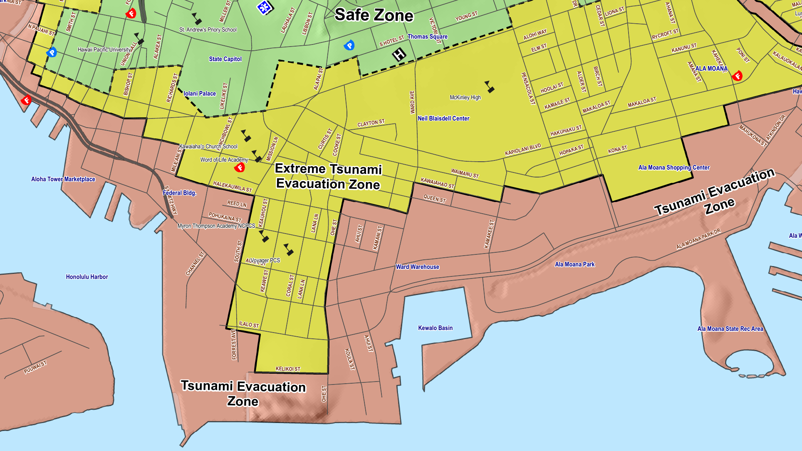
Inundation Zones
http://www.honolulu.gov/demhazards/tsunamimaps.html
Notes:
Extreme tsunami results from a magnitude 9+ earthquake, such as the Great Aleutian Tsunami

Slide 20
Tsunami Updates
Tsunami WATCH Tsunami is possible and the threat is still being evaluated
Tsunami ADVISORY
Threat of a tsunami that may produce strong currents or waves dangerous to those in or near the water
Tsunami WARNING A potential tsunami with widespread inundation is imminent or expected

Slide 21
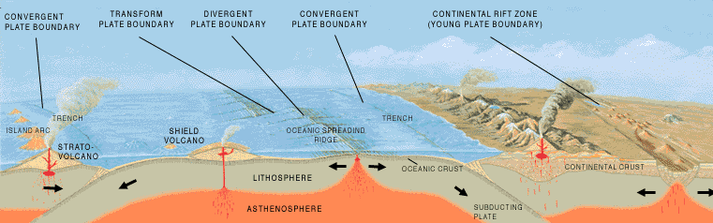
Earthquakes in Hawaii
Thousands occur in Hawaii each year
Usually linked to volcanic activity (by rock breaking as magma forces its way through underground conduits)
These types of earthquakes originate mostly on or around the island of Hawaii
Aftershocks are common

Slide 22
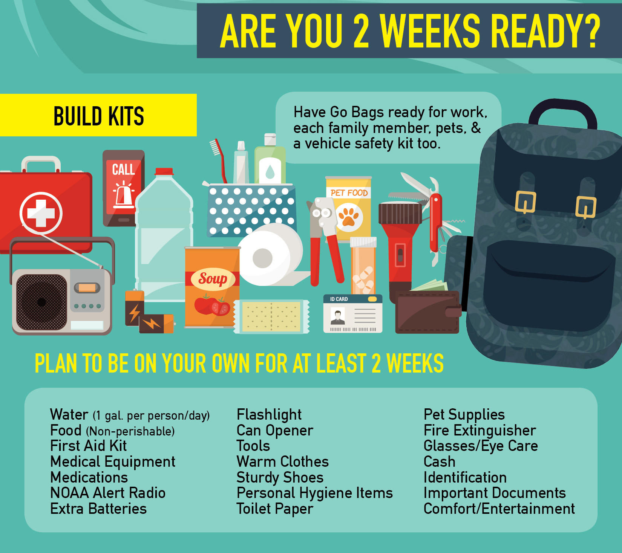
Personal Preparation
Know what to do and when to do it
Enroll in HNL.info Alerts
iTunes App Store & Google Play Store
Online at hnl.info/alerts
Be self-sufficient for 14-days
Have an Individual and Family Preparedness Plan
Participate – Community Emergency Response Teams (CERT)
Visit BePreparedHawaii.com

Slide 23
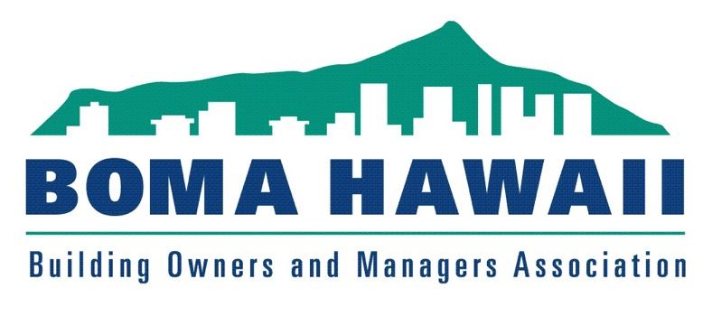
BOMA Hawaii
KHON2 Hurricane Presentation
z

Slide 24
2018 Central & East Pacific Forecast
On May 24, 2018, the National Oceanic and Atmospheric Administration released its annual forecast, predicting a 80% chance of a near- to above-average season in both the Eastern and Central Pacific basins, with a total of 14–20 named storms, 7–12 hurricanes, and 3–7 major hurricanes

Slide 25
West, Central and East Pacific... Central Pacific: 5 million sq mi Hawaii: 6,423 sq mi
z

Slide 26
Hurricane Lane: Cat 5, winds 160 mph

Slide 27
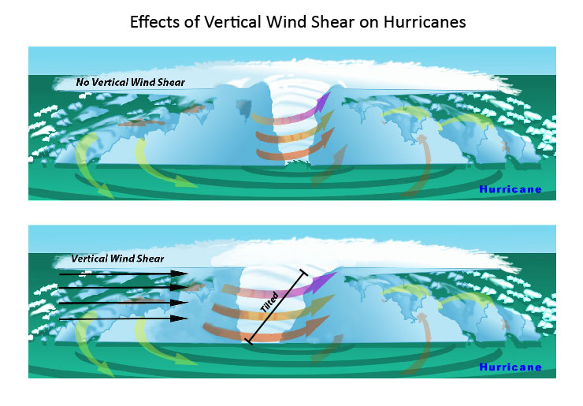
Wind Shear kills Hurricanes

Slide 28
Hurricane Olivia: Cat 3, winds 130 mph

Slide 29
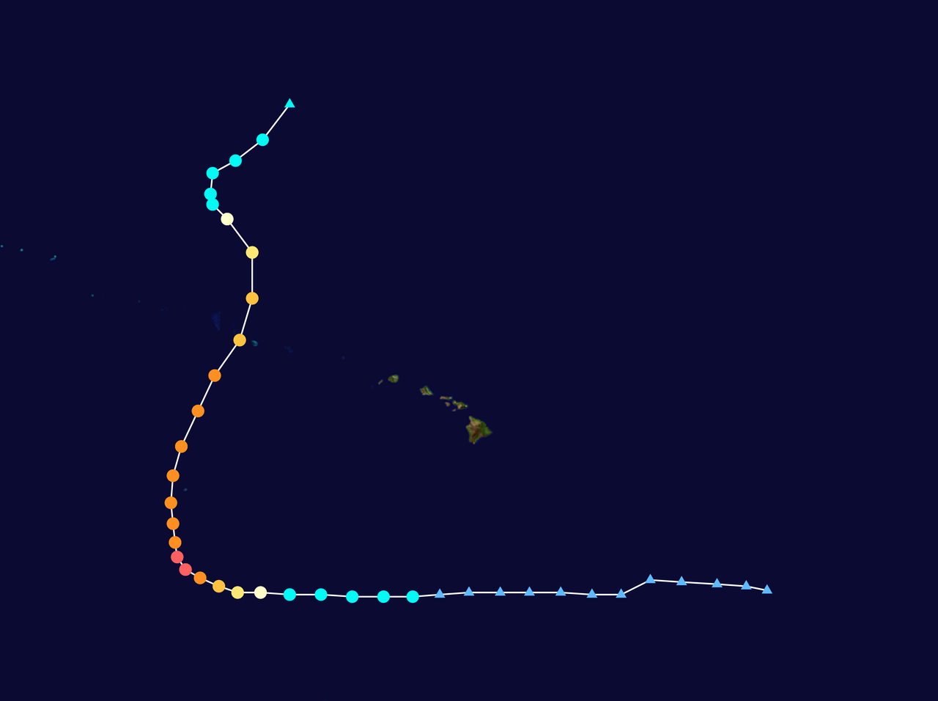
Hurricane Walaka: Cat 5, winds 160 mph

Slide 30
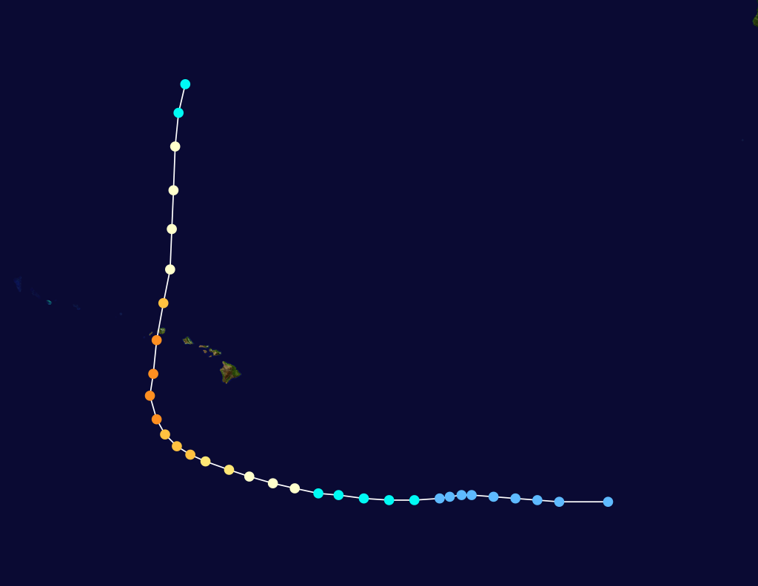
Hurricane Walaka Hurricane Iniki

Slide 31
East Pacific Hurricane Names, up next is Tara
2018 | 2019 | 2020 | 2021 | 2022 | 2023
Aletta Bud Carlotta Daniel Emilia Fabio Gilma Hector Ileana John Kristy Lane Miriam Norman Olivia Paul Rosa Sergio Tara Vicente Willa Xavier Yolanda Zeke | Alvin Barbara Cosme Dalila Erick Flossie Gil Henriette Ivo Juliette Kiko Lorena Mario Narda Octave Priscilla Raymond Sonia Tico Velma Wallis Xina York Zelda | Amanda Boris Cristina Douglas Elida Fausto Genevieve Hernan Iselle Julio Karina Lowell Marie Norbert Odalys Polo Rachel Simon Trudy Vance Winnie Xavier Yolanda Zeke | Andres Blanca Carlos Dolores Enrique Felicia Guillermo Hilda Ignacio Jimena Kevin Linda Marty Nora Olaf Pamela Rick Sandra Terry Vivian Waldo Xina York Zelda | Agatha Blas Celia Darby Estelle Frank Georgette Howard Ivette Javier Kay Lester Madeline Newton Orlene Paine Roslyn Seymour Tina Virgil Winifred Xavier Yolanda Zeke | Adrian Beatriz Calvin Dora Eugene Fernanda Greg Hilary Irwin Jova Kenneth Lidia Max Norma Otis Pilar Ramon Selma Todd Veronica Wiley Xina York Zelda

Slide 32
Central Pacific Hurricane Names, up next is Akoni

Slide 33
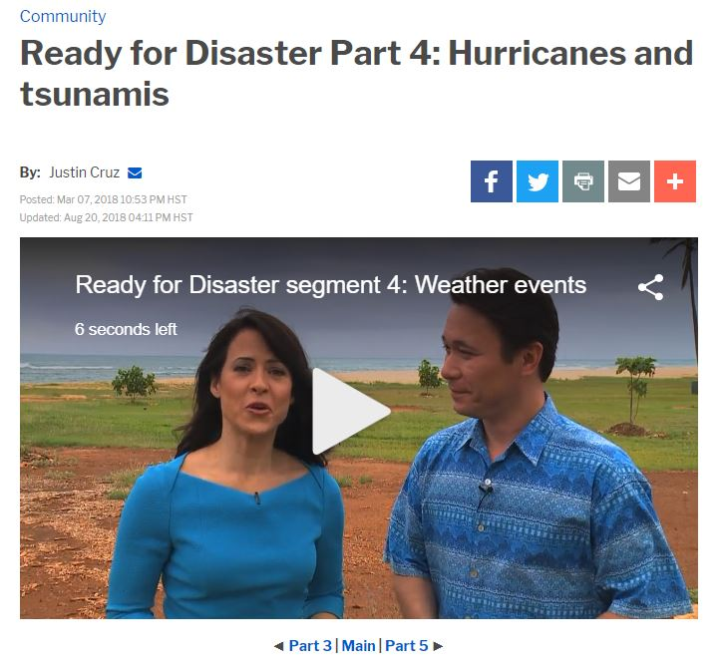
Ready For Disaster – KHON2 Special www.khon2.com
Part 1: No-notice emergencies
Part 2: Your emergency kit essentials
Part 3: Make an emergency plan
Part 4: Hurricanes and tsunamis
Part 5: Key takeaways

Slide 34
Ready for Disaster
Using the hurricane-season guideline of 14 days of supplies as a year-round, all-emergency approach covers most of the bases in terms of supplies.
Please remember these key takeaways that will help in a broad range of emergencies:
For a no-notice attack emergency: Get inside. Stay inside. Stay tuned for safety updates.
Start building those supply kits, at the very least "go kits" with a day's worth of water, food and supplies.
Start stockpiling a stay kit with 14 days worth of everything from food and water to tools, pet supplies and medications. Keep your car fueled up, too.
Sit down with your family and plan ahead. Go over how you'll stay in touch, along with who else can be emergency contacts, especially outside your area, like another island or the mainland.
Find out how your school, kupuna care home, even pet daycare will handle an emergency.
Know which room of your home is the best for sheltering in place.
Know ahead of time if you live or work in a tsunami evacuation zone.
If it's overwhelming, start simple with the “go kit” and an emergency contact list.

Slide 35
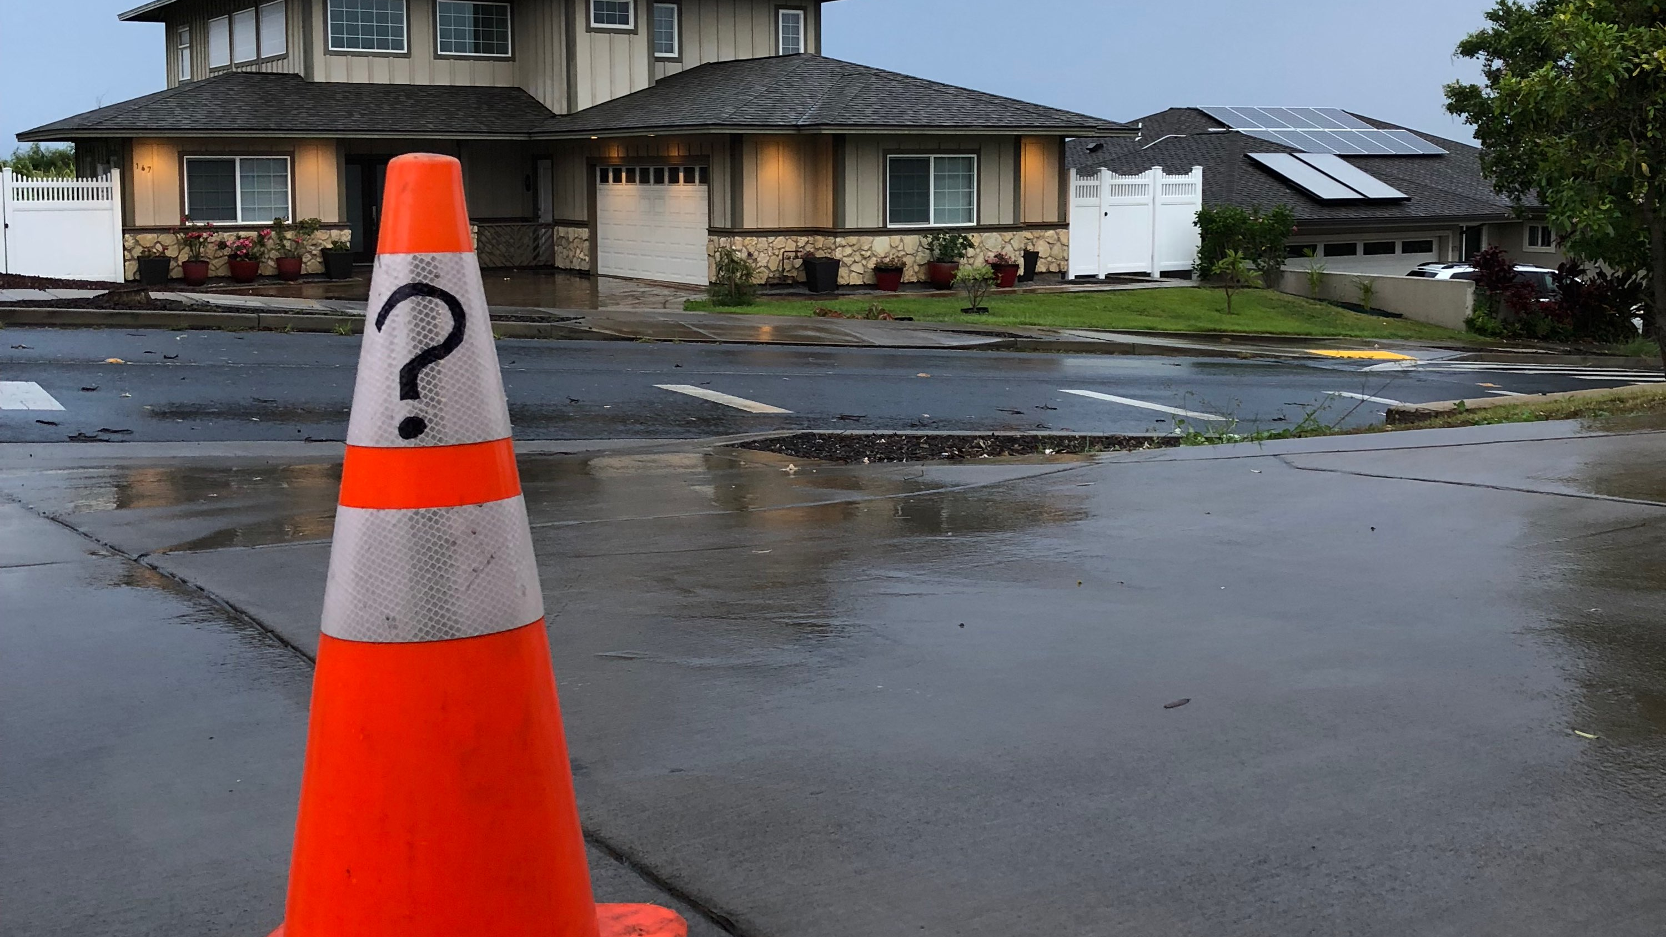
Mahalos!
Any Questions?
z

Slide 36
Emergency Preparedness Hospital Perspective
Richard Kirchner
Director of Facilities / Emergency Manager – Adventist Health Castle
Notes:
I’ll discuss emergency preparedness from a hospital perspective, with hopes to draw parallels to the business community.

Slide 37
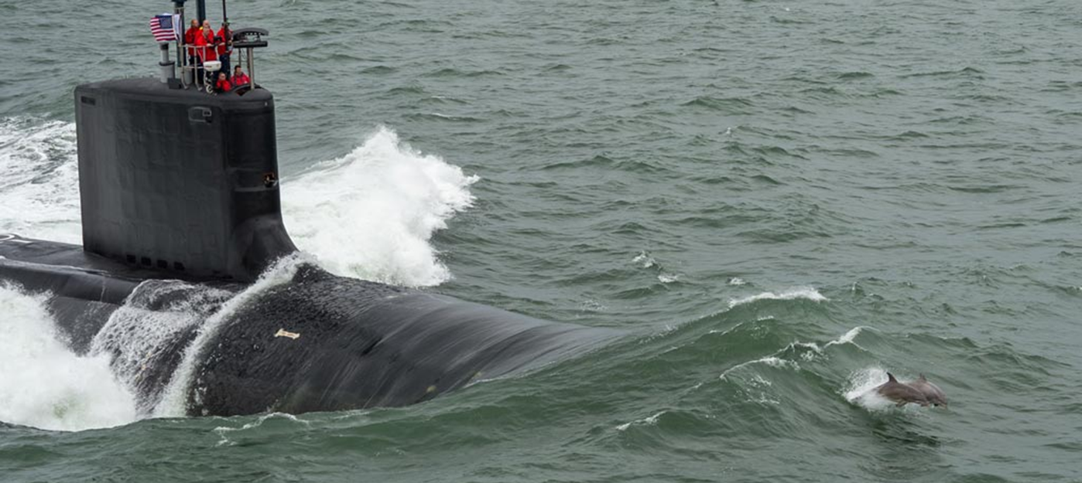
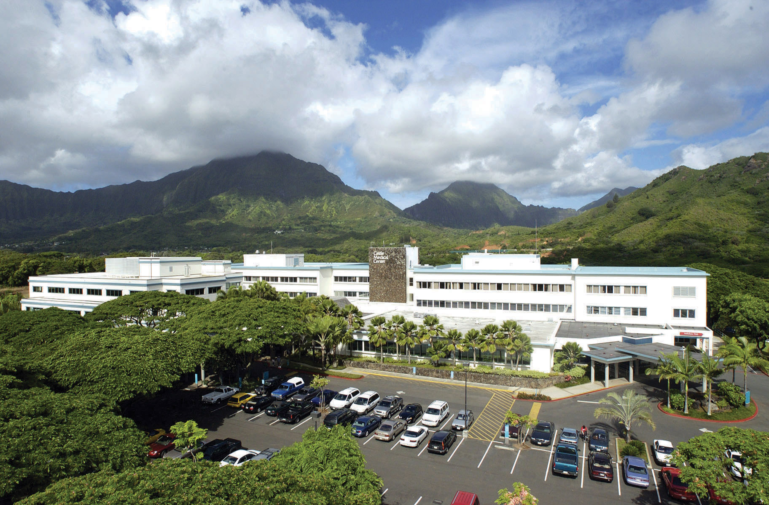
Intro
Submarine Officer - nuclear trained
Emergency Manager – Navy Nuclear Propulsion Program, Yokosuka Japan
Director of Facilities / Emergency Manager - Adventist Health Castle
Notes:
A bit of my background…
Retired submarine officer
Navy civilian working in Japan for the NNPP (Forward deployed nuclear powered aircraft carrier)
Now work for Adventist Health Castle and have the honor of working with Cherie Martyn who manages all of the Medical Office buildings. And we’ve had our share of mini disasters we’ve had to deal with.
I don’t claim to be an EM expert. EM is endless field of study and actions. Never enough resources, time, or training to devote to EM.

Slide 38
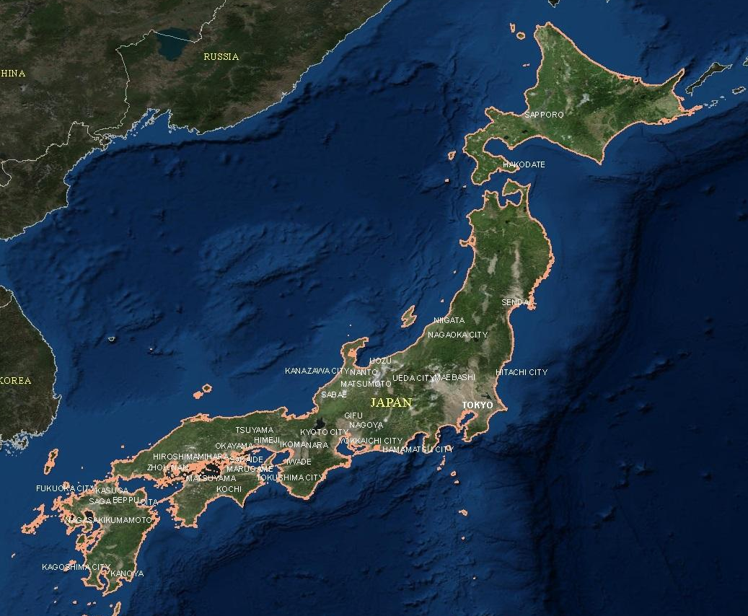
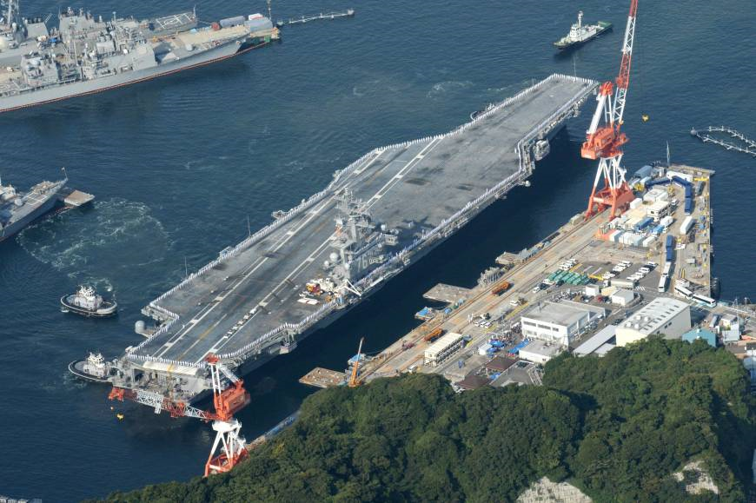
Hazards?
Notes:
While in Japan, we were located about 45 minutes south of Tokyo on Tokyo Bay.
What do you think our potential hazards were in Japan?

Slide 39
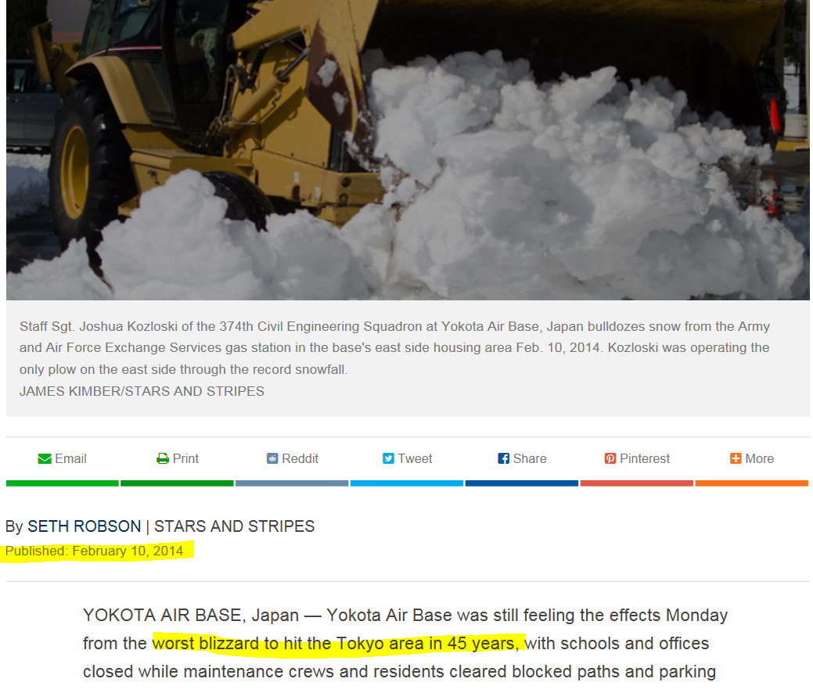
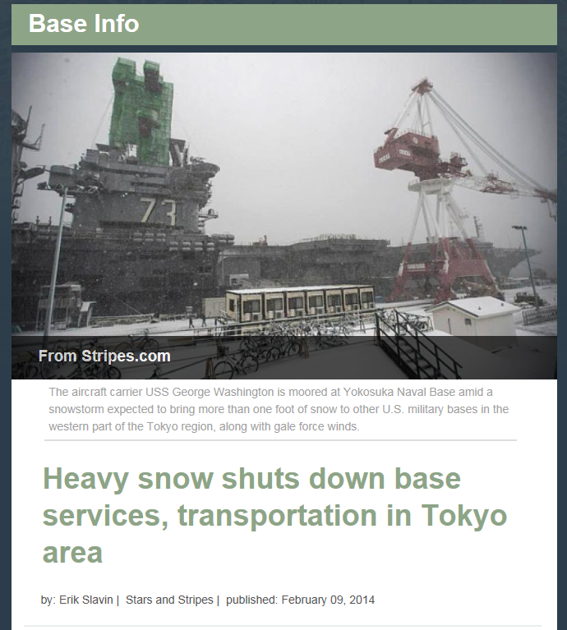
Notes:
Feb 7/8 2014 Snowstorm – once every 40 years storm
Knocked out electrical power from TEPCO. Base power plant was co-generation plant, and ship had emergency generators.
The following Monday, many places still shut down, lack of plows, we held a lessons learned / review with the base leadership. NNPP has a lot of clout over there having oversight of the Navy nuclear reactors (aircraft carrier has two) in Japan and on the base. The base leadership was not happy with a Monday meeting arguing premature and needed more time. We still held the meeting and learned more about the base power plant – that it could not be operated in island mode (without TEPCO) and that the base emergency generators could not be started up because of lack of operators. Could not get them in to start them up. The Navy doesn’t like being on it’s last line of defense, the ships generators. You need power to remove what is called “decay heat” even when the reactor is shut down. Truth is, we have other things we can do even if the ships generators go down, and the decay heat rate is very low, but from a principal standpoint, we don’t like being in this condition. So we looked critically at the base power plant and the reasons why their emergency generators were not started more promptly. Now we’re good when the next 45 year storm hits, right?

Slide 40
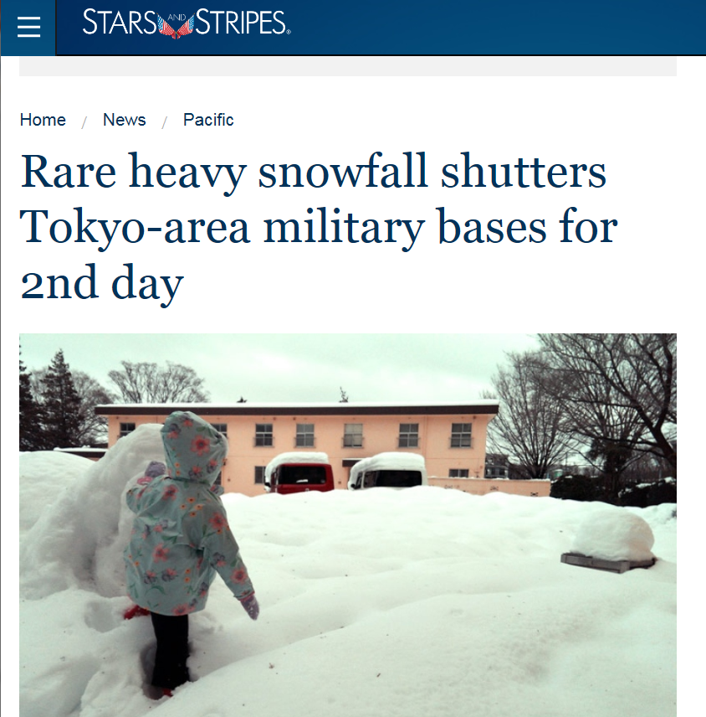
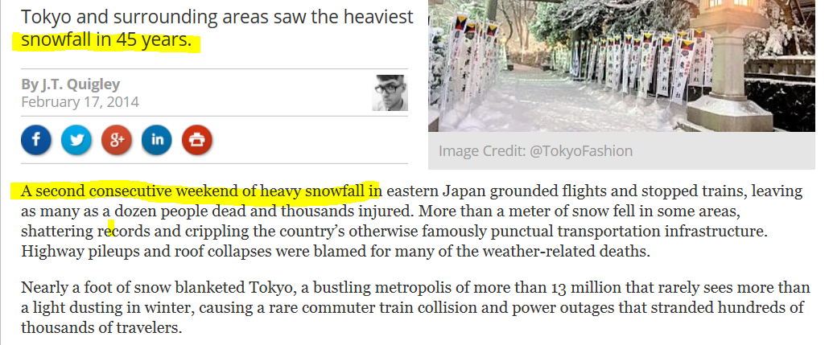
…following weekend
Notes:
February 14th, knocked out power again, (gale force winds and snow). Reason for power loss was attributed to galloping power lines.
But the base was ready. Emergency diesel operators were pre positioned on base and the generators were started up ahead of time.
Lesson, root cause analysis and take prompt corrective action.

Slide 41
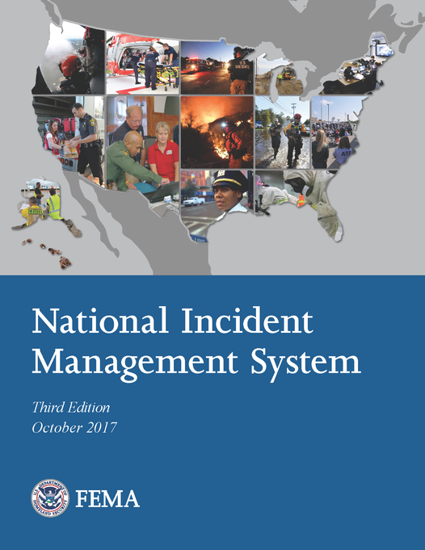
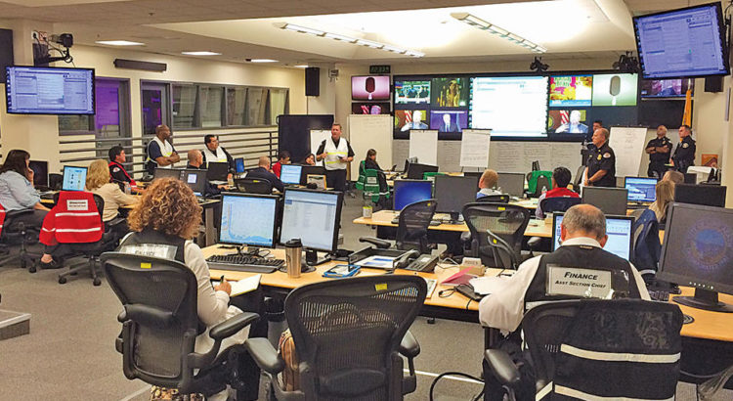
Hospital Program
NIMS – National Incident Management System
ICS – Incident Command System
HICS – Hospital Incident Command System
(Structures and Frameworks)

Slide 42
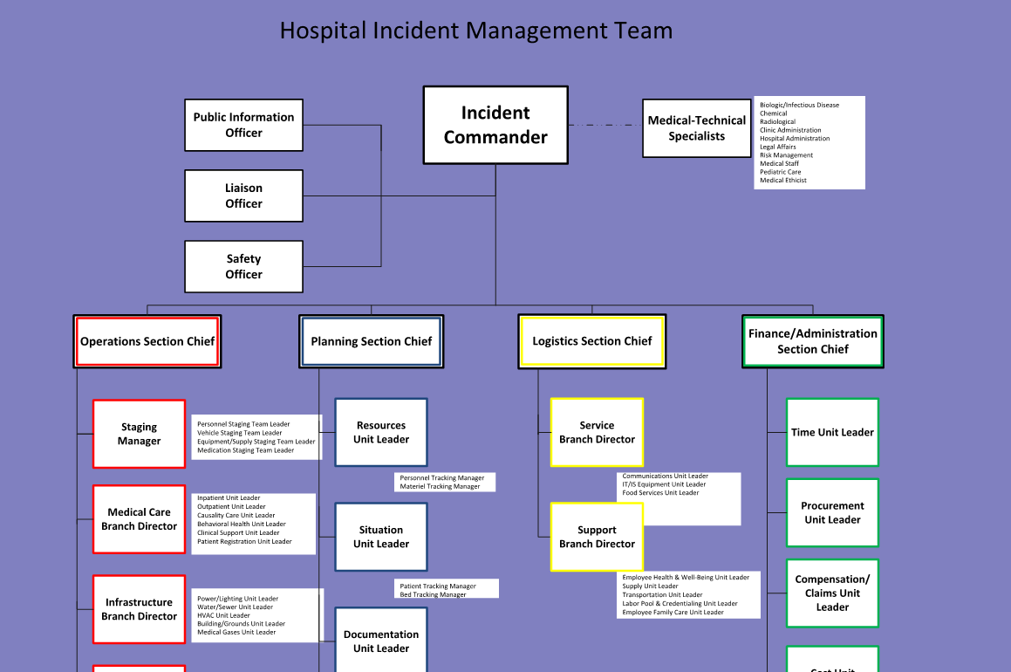
HICS – Hospital Incident Command System

Slide 43
Incident Commander
Public Information Officer
Medical – Technical Specialist
Liaison Officer
Medical Office Building Liaison
Safety Officer
Operations Section Chief
Planning Section Chief
Logistics Section Chief
Finance Section Chief
Notes:
Explain command group
Explain subgroups
Ops – doers
Planning – Planners and trackers
Logistics – Getters
Finance – counters

Slide 44
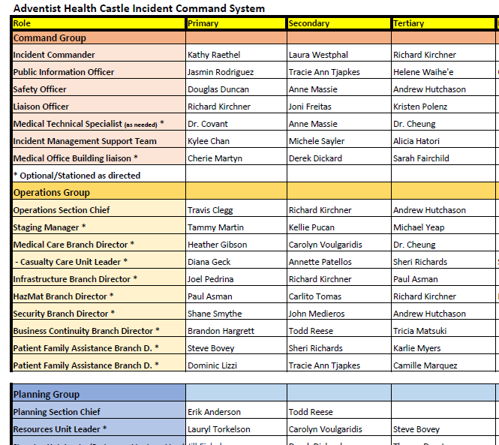
Hospital Program
Preparation (Plan)
Watchbill
Qualification Card
Checklists: Setup of Command Center
Practice (Do)
Tabletops
Training sessions
Exercises - using Hazard Vulnerability Analysis (HVA)
Review (Check)
After Action Reports – routed through CEO
Learn & Improve (Act)
Mass Casualty Protocol Cards
Include community involvement as much as possible
(Structures/Framework)
Notes:
Systems in place
Watchbill
2-3 deep. Discuss why.
These people need to be trained.

Slide 45
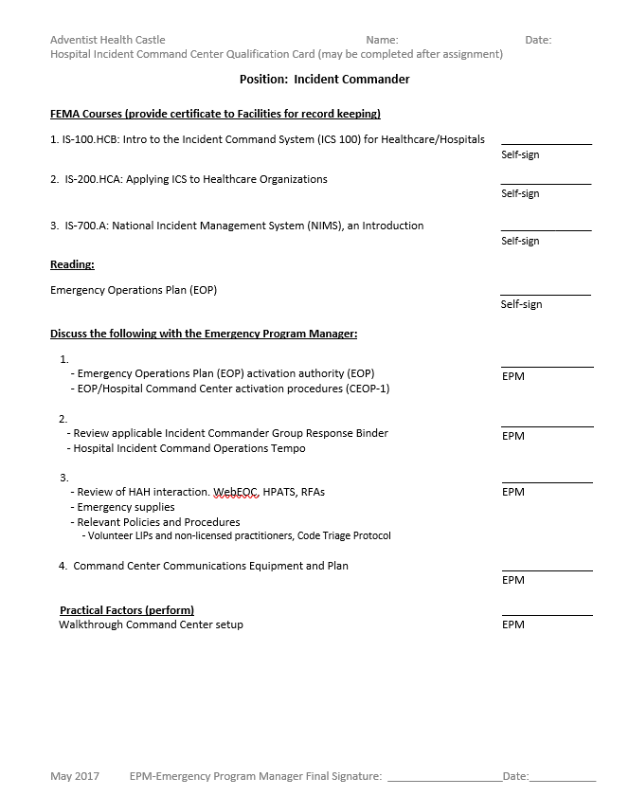
Hospital Program
Preparation (Plan)
Watchbill
Qualification Card
Checklists: Setup of Command Center
Practice (Do)
Tabletops
Training sessions
Exercises - using Hazard Vulnerability Analysis (HVA)
Review (Check)
After Action Reports – routed through CEO
Learn & Improve (Act)
Mass Casualty Protocol Cards
Include community involvement as much as possible
Notes:
So in the great Navy tradition, there is a qualification card for each position so they learn what it is that’s expected of them.
Self sign and knowledge and practical factors that I signed off at the emergency program manager.

Slide 46
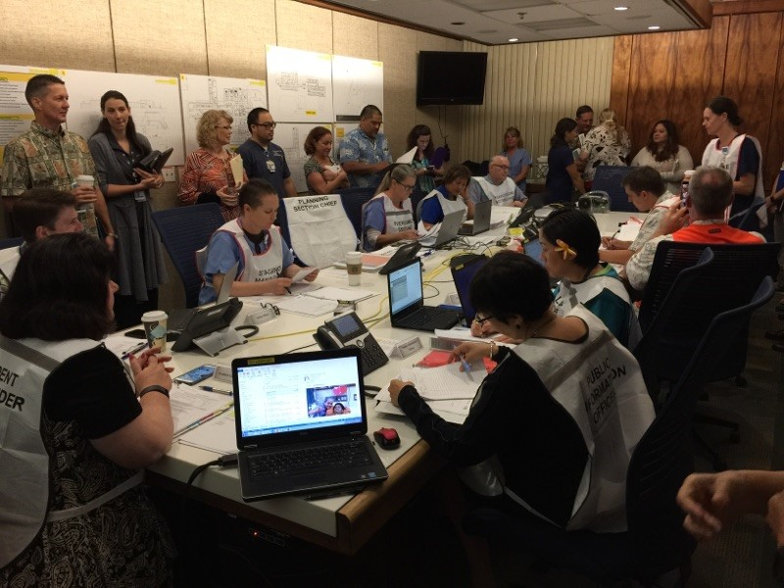
Hospital Program
Preparation (Plan)
Watchbill
Qualification Card
Checklists: Setup of Command Center
Practice (Do)
Tabletops
Training sessions
Exercises - using Hazard Vulnerability Analysis (HVA)
Review (Check)
After Action Reports – routed through CEO
Learn & Improve (Act)
Mass Casualty Protocol Cards
Include community involvement as much as possible
Notes:
Even something as simple as setting up the command center (which is our Board Room) needs a way to organize it. So we have what is called a
Priority Action Card

Slide 47
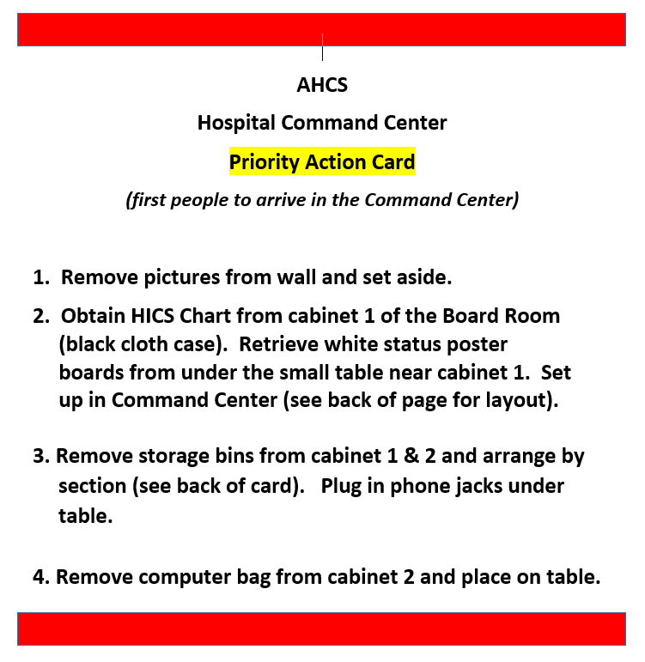
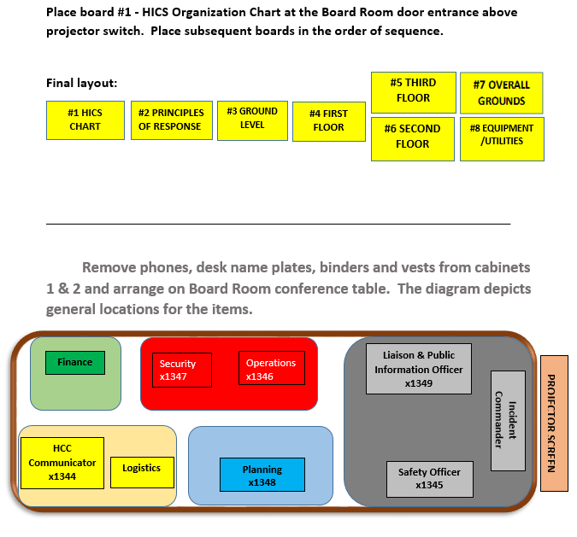
Hospital Program
Preparation (Plan)
Watchbill
Qualification Card
Checklists: Setup of Command Center
Practice (Do)
Tabletops
Training sessions
Exercises - using Hazard Vulnerability Analysis (HVA)
Review (Check)
After Action Reports – routed through CEO
Learn & Improve (Act)
Mass Casualty Protocol Cards
Include community involvement as much as possible
Notes:
Priority Action Card
Structures and Systems

Slide 48
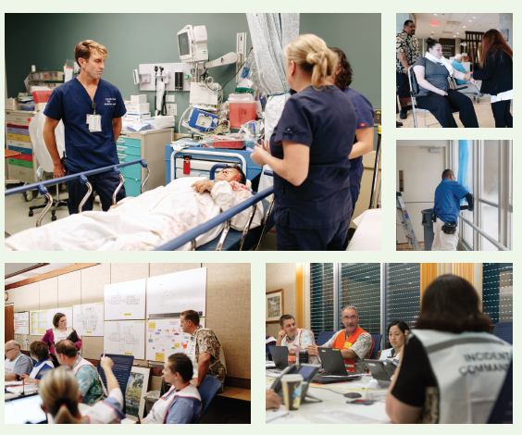
Hospital Program
Preparation (Plan)
Watchbill
Qualification Card
Checklists: Setup of Command Center
Practice (Do)
Tabletops
Training sessions
Exercises - using Hazard Vulnerability Analysis (HVA)
Review (Check)
After Action Reports – routed through CEO
Learn & Improve (Act)
Mass Casualty Protocol Cards
Include community involvement as much as possible

Slide 49
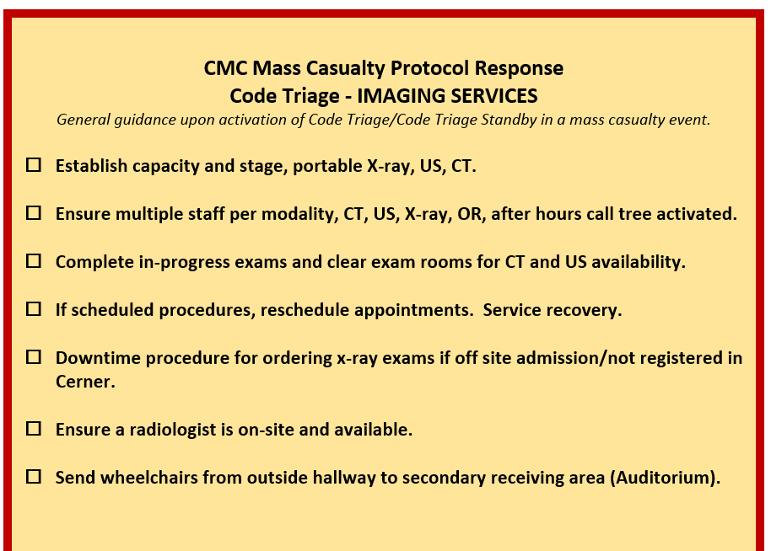
Hospital Program
Preparation (Plan)
Watchbill
Qualification Card
Checklists: Setup of Command Center
Practice (Do)
Tabletops
Training sessions
Exercises - using Hazard Vulnerability Analysis (HVA)
Review (Check)
After Action Reports – routed through CEO
Learn & Improve (Act)
Mass Casualty Protocol Cards
Include community involvement as much as possible

Slide 50
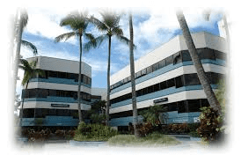
Hospital Program
Partnerships/ MOUs
Hospital Association of Hawaii
Adventist Health System
Business partners

Slide 51
Drill News video
http://www.hawaiinewsnow.com/story/36351457/terror-drill-tests-doctors-staff-at-windward-hospital

Slide 52
X
Supplier B
Businesses
Supplier A
40 %
FEMA recommendations:
Keep data in cloud
Policies for Employees, Vendors, and Customers (separate plans for each)
Continuity of Operations Plan
Identify critical/ essential operations – designate employees to carry out
Develop recovery strategies
Educate and train
Threat Analysis/ Risk Assessment
History of flooding, hurricanes, fires, cyber?
Run Drills
Your business
Notes:
How should a business approach a disaster plan. Hopefully some of the ideas I presented are applicable. But there is data and lessons from recent Hurricanes
According to FEMA – 40% of small bus never reopen after a disaster
Do you have a continuity of operations plan?
Business survive? Business operate for the good of the community? Can they continue operations for good of community and make a profit?
Data in the cloud – invoices, contracts, customer data, tax returns, insurance documents.
Red Cross recommends three separate plans.
Customers – contact numbers and a communications plan. You don’t want them leaving and going to a competitor. Is there a plan to keep them supplied during the disaster?
Employees – how payroll and leave will be affected in a disaster. If you cannot pay them for a short while, do they know what to expect or that they will be rewarded for sticking with you and getting you through the disaster.
Vendors – contact information and backup plans if vendors cannot get products to you. (a disaster in there area that is nowhere close to you). A COOP plan will look at all your vendors and identify critical ones, and backup plans if they are not available.
Communication with each of these groups – have pre-scripted messages for each group.

Slide 53
Drills
World Trade Center Evacuation Study
81% participated in fire drills, only 11% had ever entered a stairwell
Notes:
Drills can be as simple as fire evacuation drills
- Rick Rescorla
VP of Security at Morgan Stanley
Only lost 6 of 2700 employees who occupied the 44-74th floors of south tower.
Held regular drills and made employees enter the stairwells two by two and descend two stories. Amid griping of the executives that it was too much.
After north tower hit, Port Authority Direction to building occupants was to stay put. He told his staff to evacuate as they had been trained – and their training was engrained in the DNA

Slide 54
All Hazards
Prepare for the unexpected
- Mount Pinatubo
- Typhoon Yunya
Notes:
1991 our submarine was visiting the Philippines. Submarine was the USS New York City. One of the Commanding Officers of that ship was Thomas Travis who is not leading the Hawaii Emergency Management Agency.
Mt Pinatubo started erupting and the ash was all blowing the other way. But then the typhoon Yunya showed up, changed the winds and created a large scale disaster in the area.
You can see the dark circle here, that is the ash plume from the volcano in the middle of the typhoon clouds.

Slide 55
All Hazards
Prepare for the unexpected

Slide 56
All Hazards
Prepare for the unexpected
Notes:
Ash clogged condensers, caused lowering of vacuum, and threatened ability to maintain the turbine generators running.
Even your backups and defenses may be threatened.
That concludes my brief. Hopefully you can draw parallels between the hospital program and see ways to scale it to your business.

Slide 58
Introduction
22 Years in Property management, 18 of those years Class “A” mixed use Commercial
Vice President Operations | Shidler Pacific Advisors.
General Manger | Waterfront Plaza
Currently serving on multiple boards.
President 400 Keawe (2017-Current)
president; Kaka’ako Improvement Association 2014-15
President (BOMA) Building Owners Managers Association Hawaii 2014.
Notes:
My career started when I completed my contract as a Sgt in the Marine Corps. Shortly after I worked as a Security Guard at Waikiki Landmark and from there worked my way up. Don’t want to bore you but had the pleasure of managing residential and later Commercial properties. Gave allot of insight on managing personnel, property and the importance of customer service.

Slide 59
Overview
Asset – People, property, and information. - An asset is what we’re trying to protect.
Threat – Anything that can exploit a vulnerability, intentionally or accidentally, and obtain, damage, or destroy an asset. - A threat is what we’re trying to protect against.
Vulnerability – Weaknesses or gaps in a security program that can be exploited by threats to gain unauthorized access to an asset. - A vulnerability is a weakness or gap in our protection efforts.
Risk – The potential for loss, damage or destruction of an asset as a result of a threat exploiting a vulnerability. - Risk is the intersection of assets, threats, and vulnerabilities.
Notes:
Everything we do is about managing risk. Quantify, Qualify and Justify.
Identifying the 5 steps of Risk assessments (This is the very simple version)
Identify hazards, obstacles, threats
Decide who may be harmed, and how.
Assess the risks and take action.
Make a record of the findings.
Add Standard Operating Procedure
Review the risk assessment including improvements
Conduct Training and tabletop exercises (practical training on improvements)
Is the staff Protected. Is there a plan in place for their family (Will talk about that more in a future slide (Standard Operating Procedures).
Threat and vulnerability assessment – Threat/Vulnerability Assessments and risk analysis
(threat assessment considers the full spectrum of threats (i.e., natural, criminal, terrorist, accidental, etc.)and factors to limit or manage those risks
Vulnerability Assessment
Risk Analysis
Upgrade Recommendations
Re-Evaluation of Risks
Conduct Training and tabletop exercises (practical training on improvements and presentation)

Slide 60
Strengths - Weaknesses - Opportunities - Threats
Strengths: characteristics of the business or project that give it an advantage over others.
Weaknesses: characteristics of the business that place the business or project at a disadvantage relative to others.
Opportunities: elements in the environment that the business or project could exploit to its advantage.
Threats: elements in the environment that could cause trouble for the business or project.
Notes:
Managing personnel and property when a potential disaster is incoming.

Slide 61
Standard Operating Procedures
Notes:
Having standard operating procedures in place is of the utmost importance.

Slide 62
Managing The Media
Notes:
Be prepared for every possibility. Don’t forget Media and who is authorized to respond. How should they respond etc.. In Most cases we don’t want our staff to respond
if they get cornered – This is an active criminal investigation and have no comments until HPD completes its investigation.
For Hurricanes. We ask everyone to take precautions you deem necessary. Short sweet and to the point.

Slide 63
Managing The Media
Notes:
Some examples. I had the pleasure of managing Waikiki trade Center when we had 3 nightclubs. All with 4:00 a.m. liquor licenses. Not to mention in the area was over 13 nightclubs. This was 2006. That experience taught me plenty on managing risk.

Slide 74
When All Else fails Remember the basics!!!!!

Slide 75
Q and A

Slide 77
10th Annual Over the Edge
Saturday, October 27, 2018
Hyatt Regency Waikiki Beach Resort and Spa
Please Join
TeamDrop 808
and together we
can support
Special Olympics Hawaii and have a
thrilling time!

Slide 78
BOMA Hawaii has already raised over $200,000 for Special Olympics Hawaii!

Slide 81
TeamDrop 808 Hotel Room Viewing
Courtesy of Steve Sullivan

Slide 82
Team Goal is to raise $30,000
to provide 30 athletes the chance to participate in
year-round trainings and competitions.
Visit www.sohawaii.org to Register and
Sign up for TeamDrop 808

Slide 83
Mahalo for your support!

